Slide 1



Create Ansible content more efficiently by leveraging artificial intelligence
Frédéric Wautelet
University of Namur

Slide 2


Ansible LightSpeed
What is Ansible?
Free and open-source software.
Automates software deployment and configuration management.
Ensures consistency across systems.

Slide 3
Ansible LightSpeed
Ansible features
Origin and Creator
Created by Michael DeHaan in 2012.
Acquired by RedHat in 2015 and later by IBM in 2018.
Versatility in HPC Clusters
Can be used to set up Linux or Windows workstations.
Can be used to configure identical user environments on several HPC clusters.
Simplicity and Efficiency
Simple to use.
Allow management of various IT resources (servers, networks, users, software, and security settings).
Idempotence
Ansible's modules are idempotent
Ansible ensure consistent results even with multiple executions.
Agentless & SSH-Based
No need to install agent on managed resources.
Requires only SSH connection and minimal Python installation.
Beyond Configuration Management
Now evolved to handle DevOps tasks.
Automate Continuous Integration (CI), Continuous Deployment (CD), and provisioning processes.

Slide 4
Ansible installation
pip3 install ansible --user
Ansible LightSpeed
Debian based distro
$ sudo apt update
$ sudo apt -y upgrade
$ sudo apt install -y build-essential libssl-dev libffi-dev python3-dev python3-pip
$ pip3 install ansible --user
RedHat based distro
$ sudo yum install epel-release
$ sudo yum install python3-pip
$ sudo pip3 install -U pip –upgrade
$ pip3 install ansible --user
$ sudo apt update
$ sudo apt -y upgrade
$ sudo apt install -y build-essential libssl-dev libffi-dev python3-dev python3-pip
$ pip3 install ansible --user
Only available on Linux or MacOS.
Can be installed in user space.
Can be installed using Virtualenv.
$ sudo yum install epel-release
$ sudo yum install python3-pip
$ sudo pip3 install -U pip –upgrade
$ pip3 install ansible --user

Slide 5
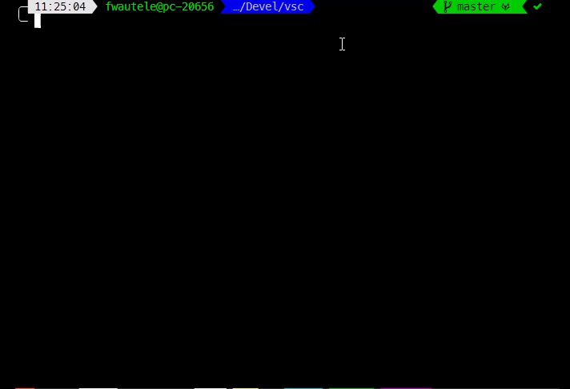
Custom installation
Ansible LightSpeed
If you need a specific version or if you need to install multiple Ansible versions.
In a Python virtualenv.
Using pip.
Steps to install:
Create Python virtualenv
Install Ansible using pip
Check version
Exit virtualenv
Activate the virtualenv to use Ansible.

Slide 6
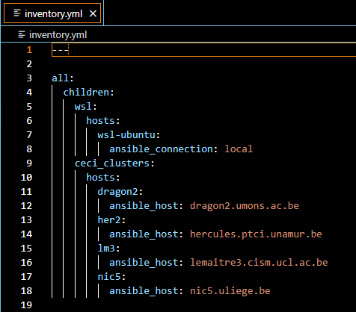
Ansible Inventory
Ansible LightSpeed
List of managed hosts that Ansible configures.
Hosts can be grouped.
Use client ssh config.
Useful for ProxyJump.
Possibility of more complex setup.
Hosts in multiple groups.
parent/child relationships among groups.
Ranges of hosts.
…

Slide 7
Anatomy of an Ansible playbook
Ansible LightSpeed
Playbook
Play
Task
Playbooks are written in YAML format.
Play: Contains a list of tasks to be performed on the hosts.
Hosts: Specifies the target hosts or groups where tasks will be executed.
Tasks: the smallest unit of action you can automate. Use Ansible Modules.
Ansible modules are predefined scripts for specific tasks like file manipulation, package installation, or service management.
Task
Task
Task
Play

Slide 8
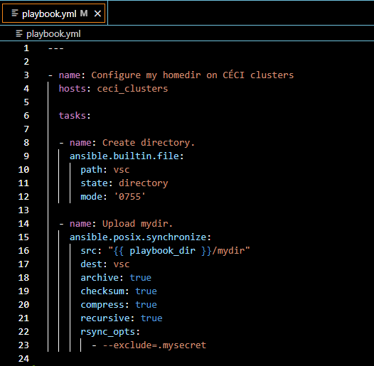
My first Ansible playbook
Ansible LightSpeed
“Set up” my homedir on several HPC clusters.
Example:
Create directory on remote
Copy local tree to remote
Can be much more complex…

Slide 9

Play my playbook
Ansible LightSpeed
Activate virtualenv
source ~/.venv/ansible/bin/activate
Run Ansible
ansible-playbook -i inventory.yml -l ceci_clusters playbook.yml

Slide 10
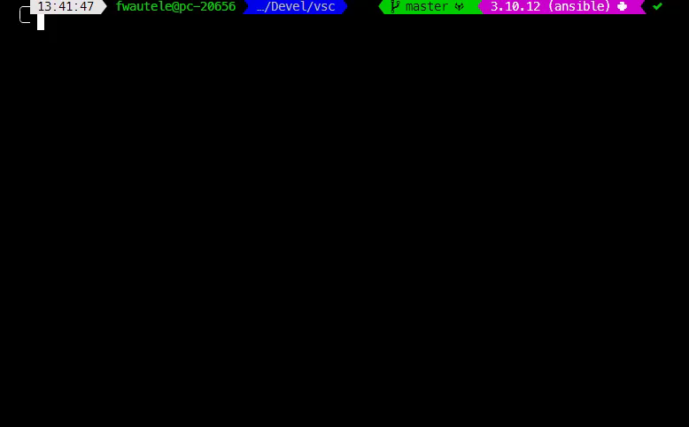
Idempotent play
Ansible LightSpeed
If I re-run this play, nothing will be changed.
Almost all Ansible modules are idempotent.

Slide 11
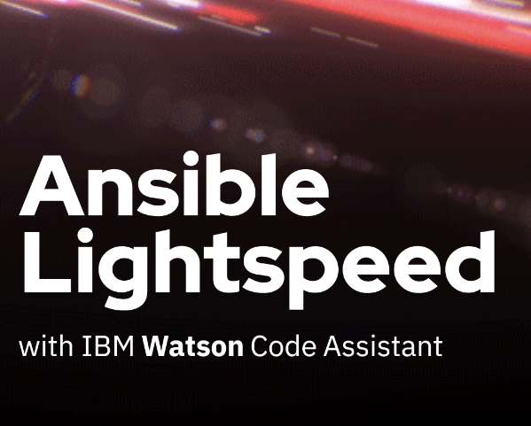
What is Ansible Lighspeed?
Ansible LightSpeed
VSCODE extension.
Use natural language processing.
Reads task description in plain English.
Generate Ansible code.
Require a GitHub account.

Slide 12
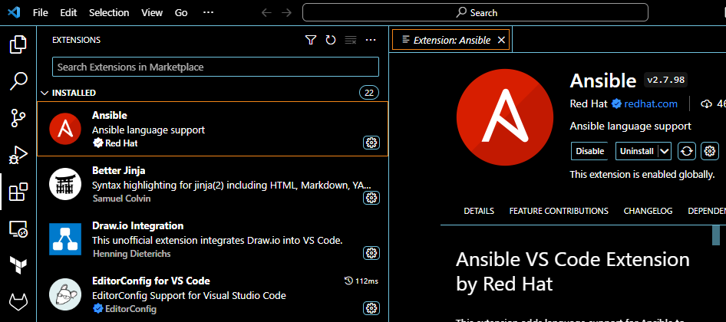
Step 1: install VS Code extension
Ansible LightSpeed
2
Search Ansible on the marketplace.
Install the official extension by Red Hat.
1

Slide 13
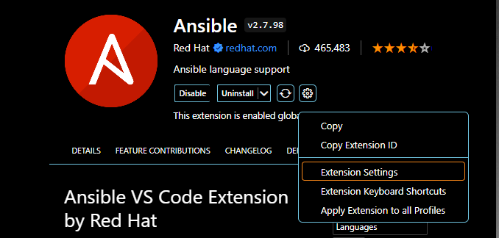
Step 2: enable LightSpeed
Ansible LightSpeed
1
Go to Ansible extension settings

Slide 14
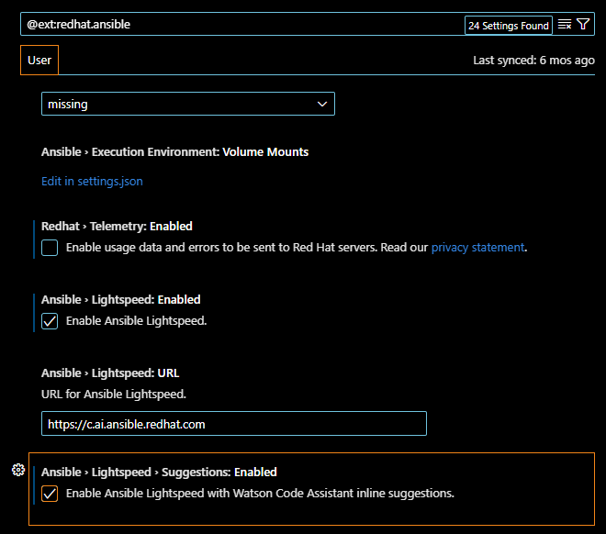
Step 2: enable LightSpeed
Ansible LightSpeed
Go to Ansible extension settings
Enable LightSpeed
2
2

Slide 15
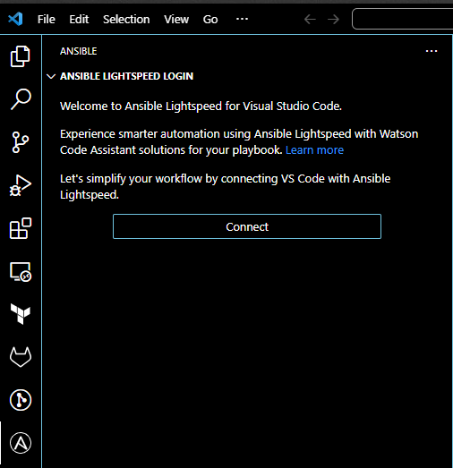
Step 3: Connect VS Code with Lightspeed.
Ansible LightSpeed
Navigate to the Ansible icon on the left-hand side
Then click Connect.
2
1

Slide 16
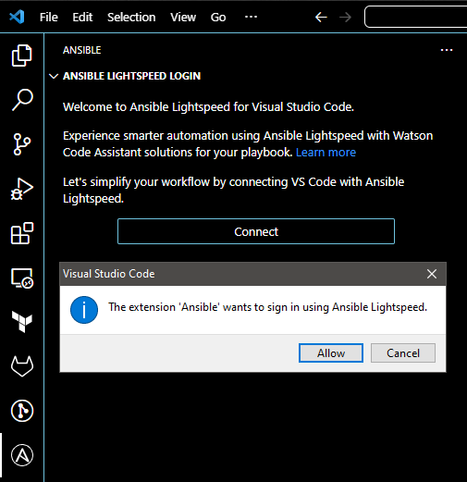
Step 3: Connect VS Code with Lightspeed.
Ansible LightSpeed
Navigate to the Ansible icon on the left-hand side
Then click Connect.
Click Allow
3

Slide 17
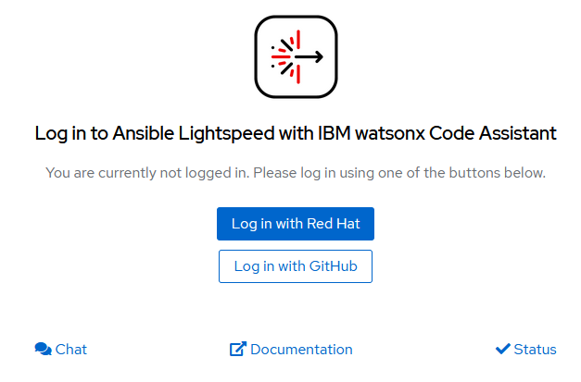
Step 3: Connect VS Code with Lightspeed.
Ansible LightSpeed
Navigate to the Ansible icon on the left-hand side
Then click Connect.
Click Allow
Log in using your GitHub account

Slide 18
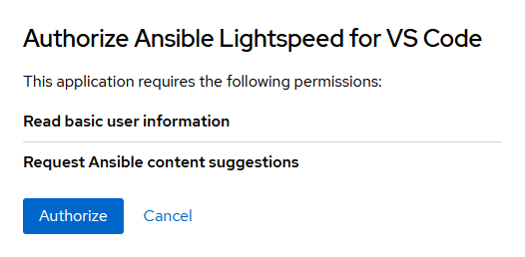
Step 3: Connect VS Code with Lightspeed.
Ansible LightSpeed
Navigate to the Ansible icon on the left-hand side
Then click Connect.
Click Allow
Log in using your GitHub account
Authorize to give it permission.

Slide 19
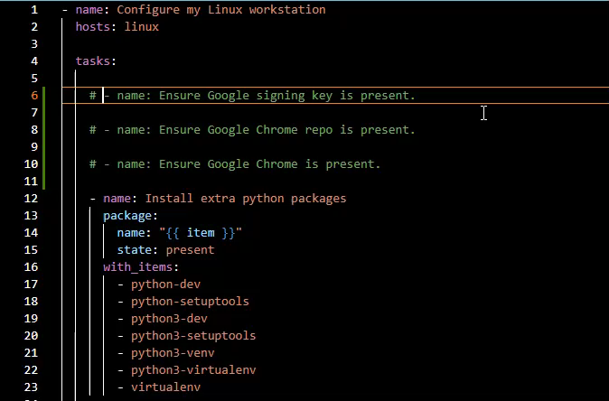
Let’s generate!
Ansible LightSpeed
Create a YAML file.
Define the task only by describing it in the name section.
Put your cursor at the end of the task description, then press Enter.
Wait for Lightspeed to generate and a preview of the suggestion will appear.
Press TAB if you’re fine with the generated task and turn it into active text.

Slide 20

Ansible LightSpeed
Conclusions
Other AI tools that are not specifically designed to generate Ansible code struggle to generate code that respects Ansible best practices.
As users continue to use Ansible Lightspeed, model recommendations will continually improve based on the additional data available for artificial intelligence models.
The tool is promising and offers a significant productivity boost. He saves time by automating repetitive tasks.
Ansible Lightspeed is still available free of charge to all Ansible users.

Slide 21



ChatGPT-for-HPC
Jeff Geerling’s
Ansible Content
Ansible Lightspeed with IBM
watsonx Code Assistant

